Slide 1
EXAMS & EAA

Slide 2
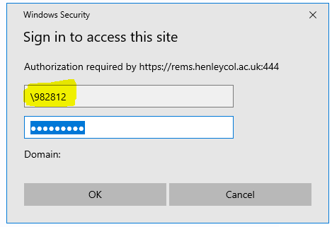
LOG IN TO YOUR REMS PORTAL

Slide 3
Back slash
You must put a backslash before your student reference if you are using an I-Phone.
\
Android phones you just enter your student reference
Password is your normal e-mail password.

Slide 4
Click on Learner Portal -- My Details

Slide 5
Click on Exams tab

Slide 6
Click Timetable and it will show the exam date, title, start, finish, room and seat.

Slide 7
Instructions
Please arrive at least 30 minutes before your exam is due to start
Please bring all equipment that you need for the exam
Only clear water is allowed into the exam rooms
Clear drink containers / no labels
No watches or electronic devices allowed in the exam rooms
Lanyards MUST be worn for identification purposes
No student is to leave the exam room early

Slide 8
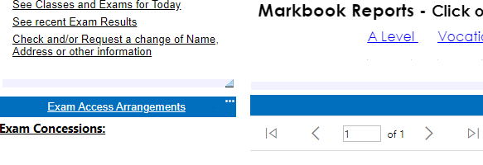
EAA's On your home page

Slide 9
Contact details
Access to your Portal – ITServiceDesk@henleycol.ac.uk
Exam details – nagr@henleycol.ac.uk
Chmo@henleycol.ac.uk
EAA's - Exams@henleycol.ac.uk

